Slide 1

SDO – The Big !dea
Object Model Impact Assessment Tool – Team Coral

Slide 2




Team Details
Pranav Joshi
Manager
pranjoshi@deloitte.com
Mohammed Atif
Consultant
mohatif@deloitte.com
Punit Gupta
BTA
punigupta@deloitte.com
Raju Mohan
BTA
rajmohan@deloitte.com
TEAM LEAD – Pranav Joshi

Slide 3
Description of Problem / Opportunity
PREMISE
Large Scale Integration/Modernization Projects deals with multiple Business Model, Application Models and there mapping
Information stored in disparate sources using static tools like MS – Excel
Open source requirement tools like JIRA do not provide capability to capture and visualize these information
OPPORTUNITY
5 – 7% of effort saving per sprint
5 - 8 Hours per feature to analyze the impact of change
On an average, two fields change every sprint
Cost of Quality
Identifying issues early in the Application development phase
40% of the Feature Testing bugs due to mapping issues
Governance framework through automation will ensure the quality of documentation
PROBLEM
Mappings prone to change resulting in iterative impact analysis
Manual and Reactive Process, thereby making the process cumbersome and time consuming*
Prone to error due to multiple sources and versions
No tool to hold and visualize the mappings

Slide 4
Solution Description
The Big !dea
FEATURES
Object model impact assessment tool to identify the dependencies and impact of change
One Stop Shop
Data Load and Cleansing
Interface to load the Business Fields and Object Models
Premise for Impact Assessment
Interface to enter the field to analyze the impact of change
Visualization
Generates reports and visualizations of the impact
01
To manage all the object models, there mapping with business fields and User Stories
Proactive Analysis
Scheduled monitor to identify the changes
02
Alert System
03
Automated notification system to intimate the stakeholders of the change
Visualization
List Versus Nodal Graph Representation; Better view of the derived fields
04
VALUE PROPOSITION
Reports
05
Reports can be generated in commonly accepted file formats like PDF, HTML
Offers visual representation of the impact of change
Saves time by 5 - 7%
Automated Process; Not Prone to error
Can be customized to assess relationship any type of data
Automatic Mapping
Read User Stories from JIRA and leverage BIM to generate User Story level mapping;
06

Slide 5
High-Level Technology Architecture
TECHNOLOGY INFRASTRUCTURE
R – Analytical Engine
My SQL Database
Angular UI
Java
Windows Scheduler
RATIONALE
Open Source, hence, the licensing cost is minimal

Slide 6
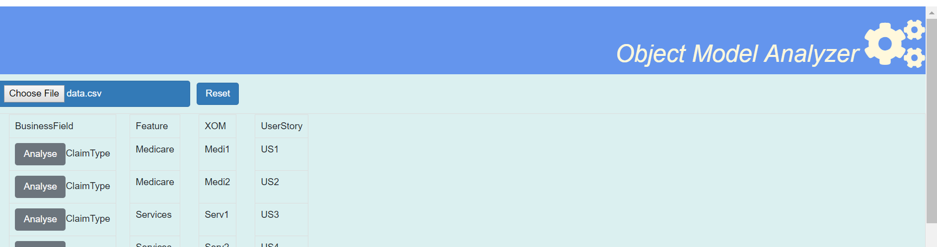
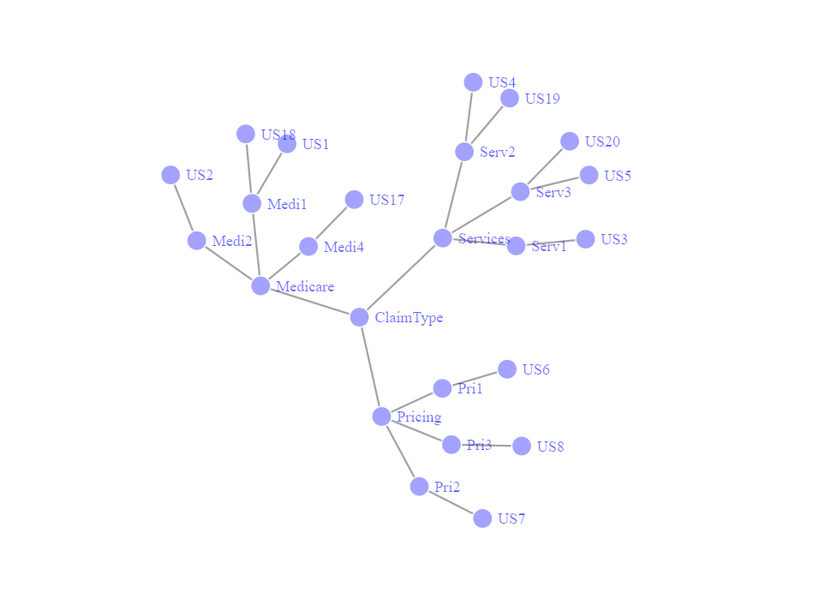
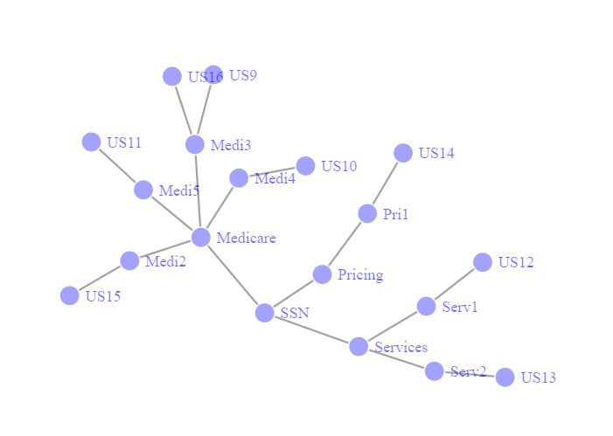
Demo

Slide 7
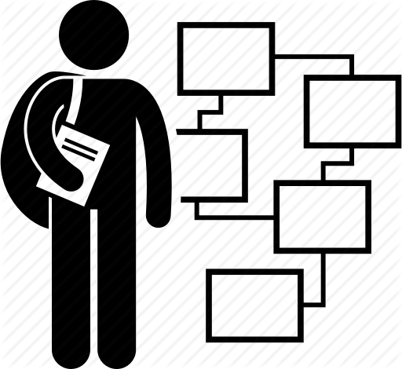

Impact to SDO Practice/Client
USERS
ALIGNMENT WITH SDO
Systems Analyst
Leverage to determine the technical fields for the corresponding business fields
Impact Analysis to identify the components of change
Making SDO a destination with acceleration across channels of effective and efficient delivery of technology offerings in support of changing business needs by managing the complexity associated with large-scale technology change.
Enhancement to Requirement Management Tools aligning with “Business Process Design” service offerings
Deloitte committed to large scale transformation project where this tool will act as a differentiator
Enabler to “Operate” for Change Requests
Business Analyst
Leverage to manage business fields and definition
Impact Analysis for the mapping changes to estimate the effort of change

Slide 8
?

